Slide 1
NLP Lecture 9 Document Classification Recommender Systems

Slide 2
Linear Algebra Background

Slide 3

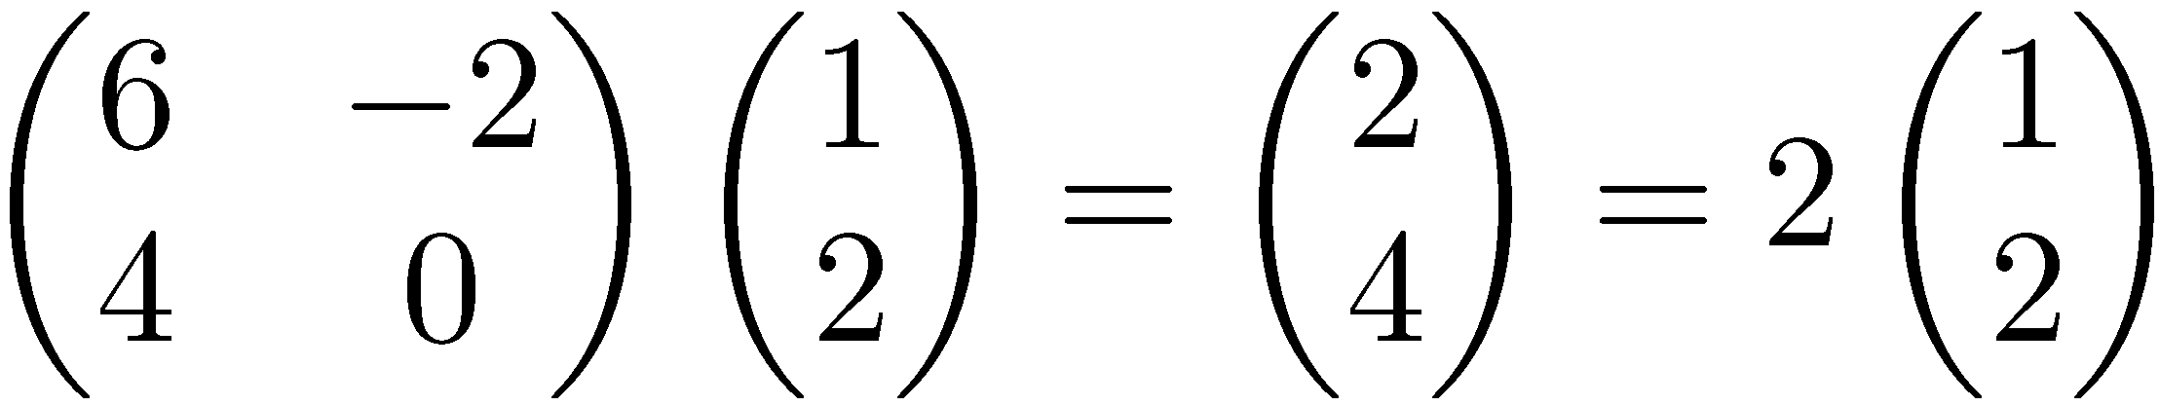
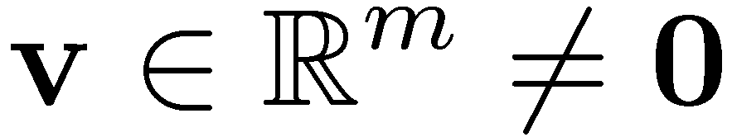

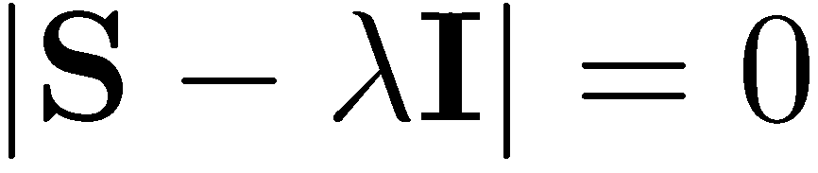
Eigenvalues & Eigenvectors
Eigenvectors (for a square m×m matrix S)
How many eigenvalues are there at most?
Example
(right) eigenvector
eigenvalue
only has a non-zero solution if
this is a m-th order equation in λ which can have at most m distinct solutions (roots of the characteristic polynomial) – can be complex even though S is real.

Slide 4
Matrix-vector multiplication
has eigenvalues 3, 2, 0 with
corresponding eigenvectors
On each eigenvector, S acts as a multiple of the identity
matrix: but as a different multiple on each.
Any vector (say x= ) can be viewed as a combination of
the eigenvectors: x = 2v₁ + 4v₂ + 6v₃

Slide 5
Eigenvalues & Eigenvectors
For symmetric matrices, eigenvectors for distinct
eigenvalues are orthogonal
All eigenvalues of a real symmetric matrix are real.
All eigenvalues of a positive semidefinite matrix
are non-negative

Slide 6
Example
Let
Then
The eigenvalues are 1 and 3 (nonnegative, real).
The eigenvectors are orthogonal (and real):
Real, symmetric.
Plug in these values and solve for eigenvectors.

Slide 7
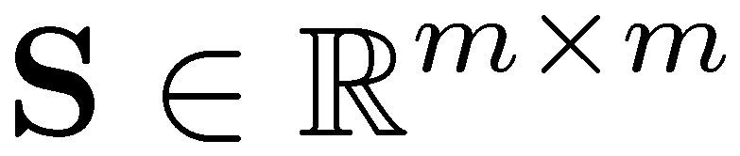
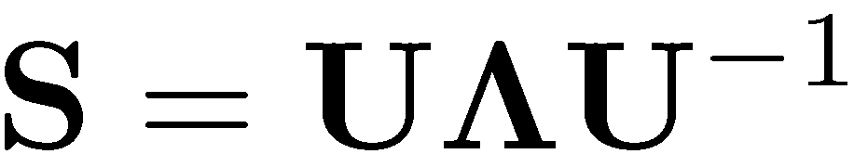


Eigen/diagonal Decomposition
Let be a square matrix with m linearly independent eigenvectors (a “non-defective” matrix)Theorem: Exists an eigen decomposition
(cf. matrix diagonalization theorem)
Columns of U are eigenvectors of S
Diagonal elements of are eigenvalues of
diagonal
Unique for distinct eigen-values

Slide 8
Diagonal decomposition: why/how
Let U have the eigenvectors as columns:
Then, SU can be written
Thus SU=UΛ, or U^{–1}SU=Λ
And S=UΛU^{–1}.

Slide 9
Diagonal decomposition - example
Recall
The eigenvectors and form
Recall
UU^{–1} =1.
Inverting, we have
Then, S=UΛU^{–1} =

Slide 10
Example continued
Let’s divide U (and multiply U^{–1}) by
Then, S=
Q
Λ
(Q⁻¹= Q^{T} )
Why? Stay tuned …

Slide 11
Symmetric Eigen Decomposition
If is a symmetric matrix:
Theorem: Exists a (unique) eigen decomposition
where Q is orthogonal:
Q⁻¹= Q^{T}
Columns of Q are normalized eigenvectors
Columns are orthogonal.
(everything is real)

Slide 12
Exercise
Examine the symmetric eigen decomposition, if any, for each of the following matrices:

Slide 13
Comment about EVD
We want to deal with text or term-doc matrices
What do these matrices have to do with text?
Term-doc matrices are rectangular
But everything so far needs square matrices for EVD
Recall m× n term-document matrices …

Slide 14
Singular Value Decomposition
For an m× n matrix A of rank r there exists a factorization
(Singular Value Decomposition = SVD) as follows:
m×m
m×n
V is n×n
The columns of U are orthogonal eigenvectors of AA^{T}.
The columns of V are orthogonal eigenvectors of A^{T}A.
Eigenvalues λ₁ … λ_{r} of AA^{T} are the eigenvalues of A^{T}A.
Singular values.

Slide 15
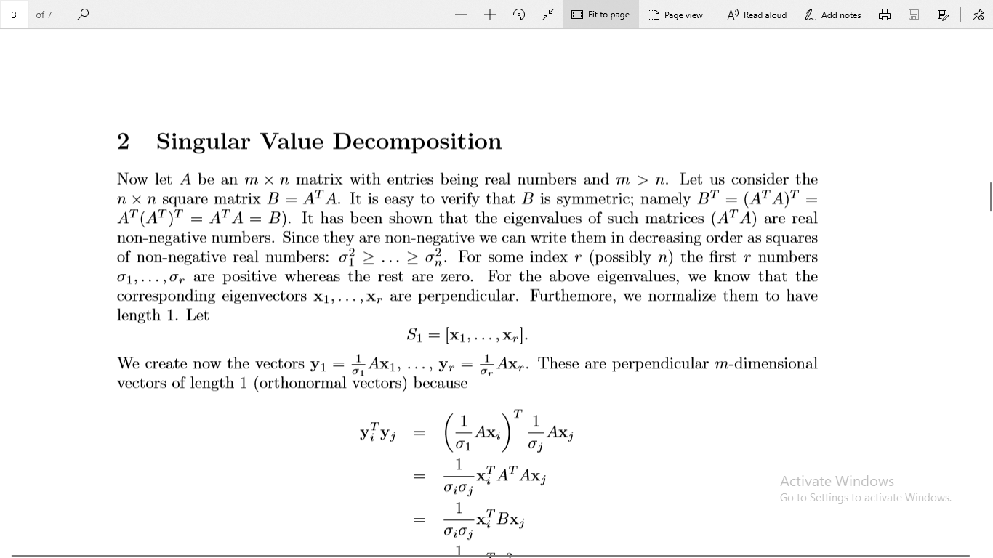

Slide 16
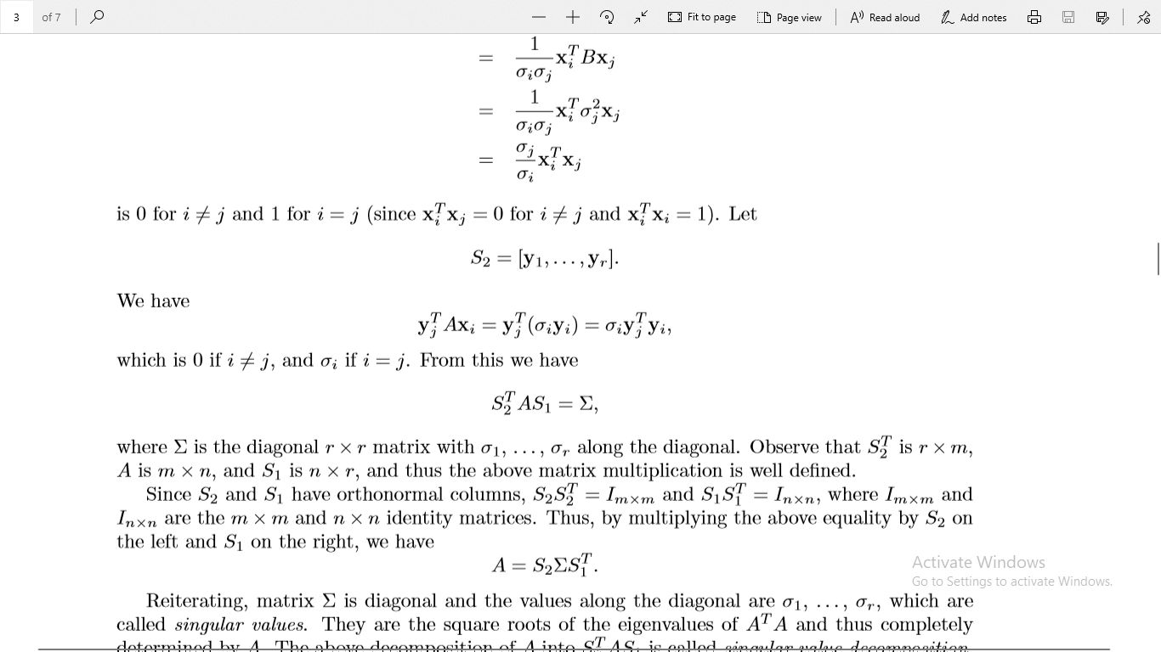

Slide 17
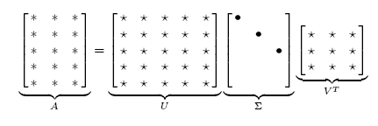
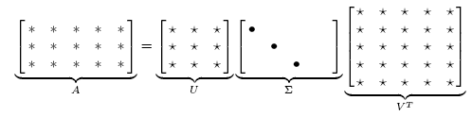
Singular Value Decomposition
Illustration of SVD dimensions and sparseness

Slide 18
SVD example
Let
Thus m=3, n=2. Its SVD is
Typically, the singular values arranged in decreasing order.

Slide 19
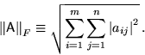
Low-rank Approximation
SVD can be used to compute optimal low-rank approximations.
Approximation problem: Find A_{k} of rank k such that
A_{k} and X are both m×n matrices.
Typically, want k << r.
Frobenius norm

Slide 20
Low-rank Approximation
Solution via SVD
set smallest r-k
singular values to zero
k
column notation: sum
of rank 1 matrices

Slide 21
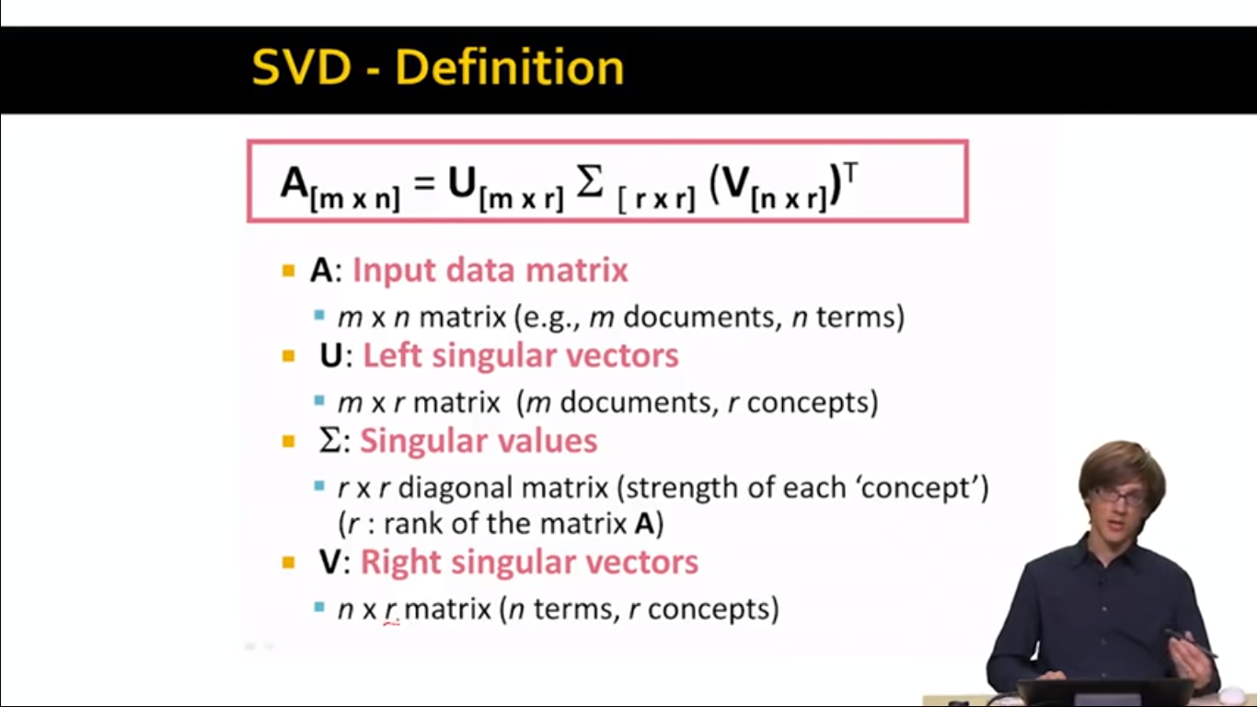

Slide 22
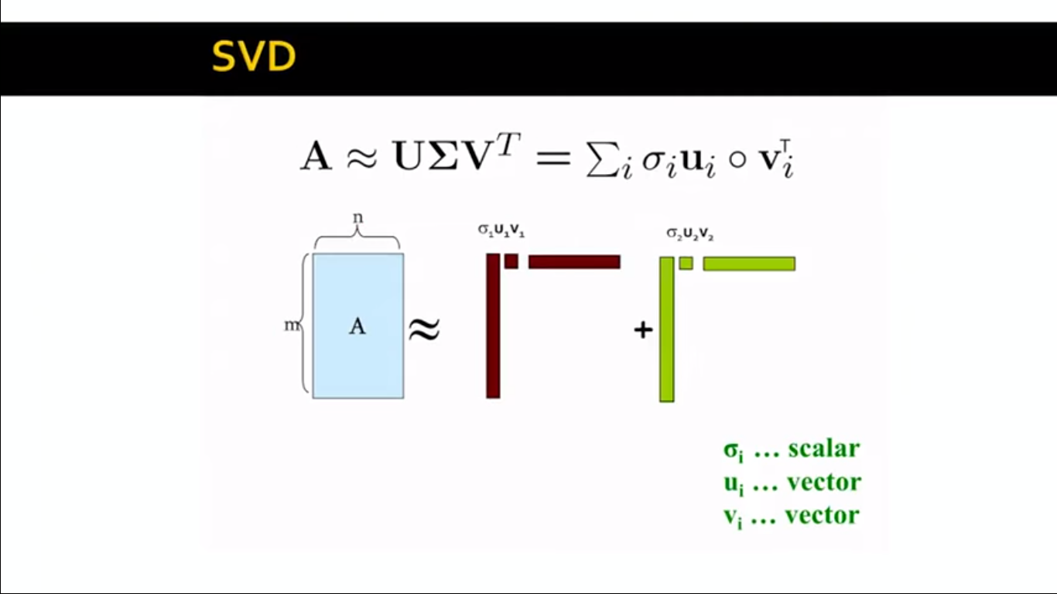

Slide 23
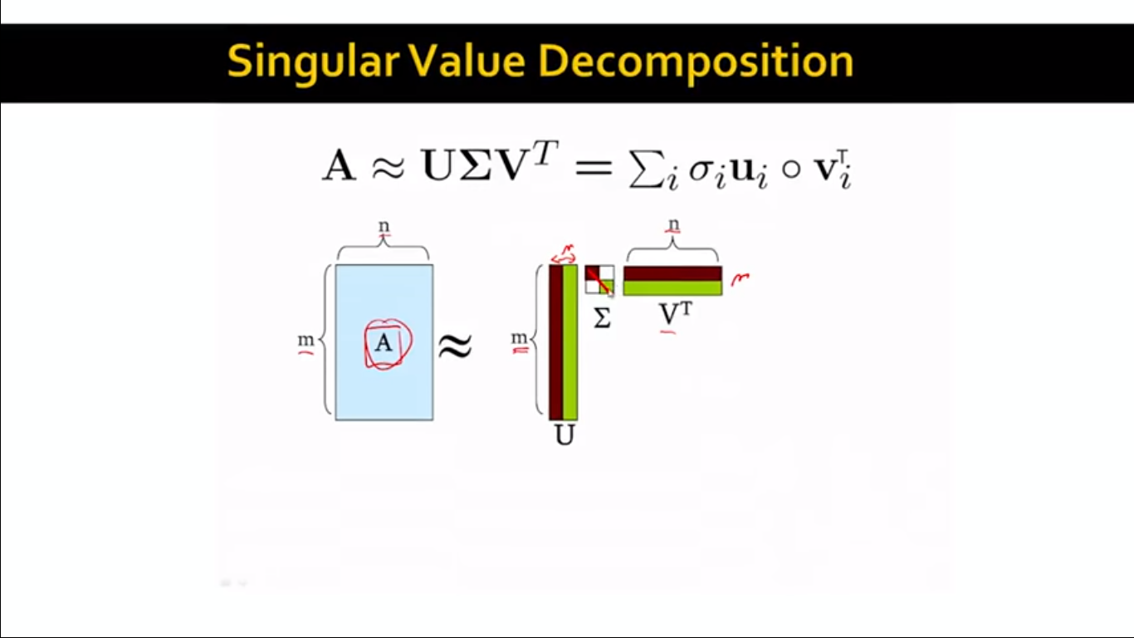

Slide 24
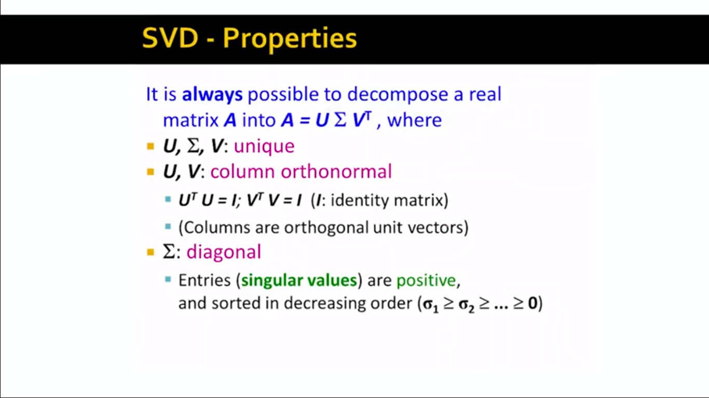

Slide 25
Latent Semantic indexing

Slide 26


Slide 27
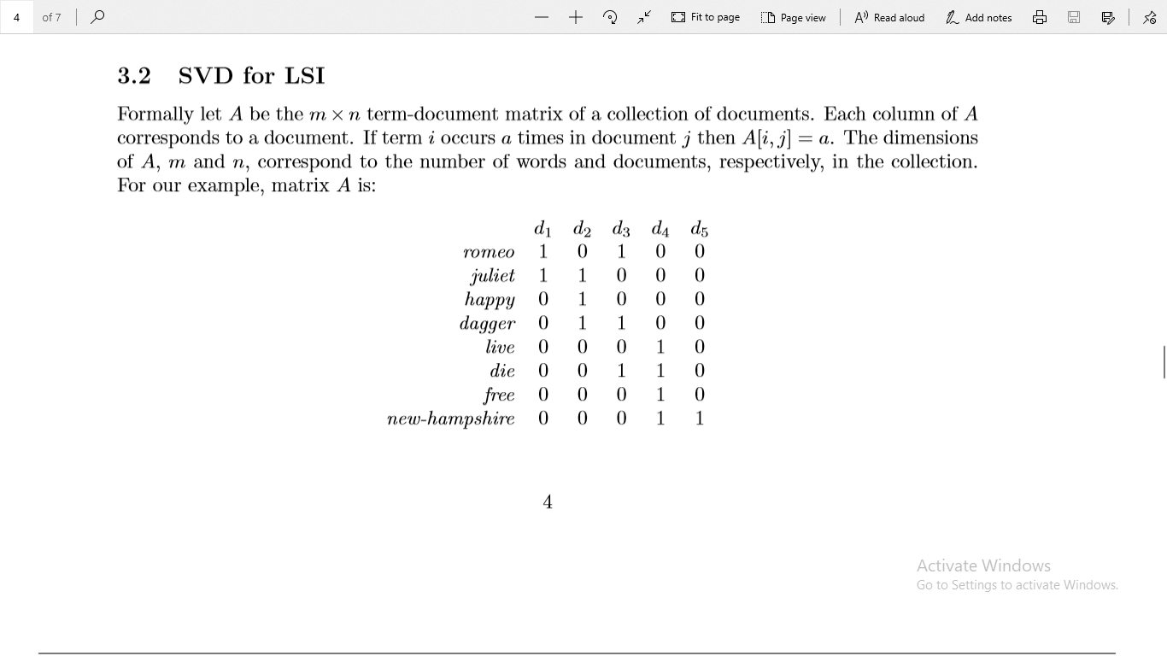

Slide 28
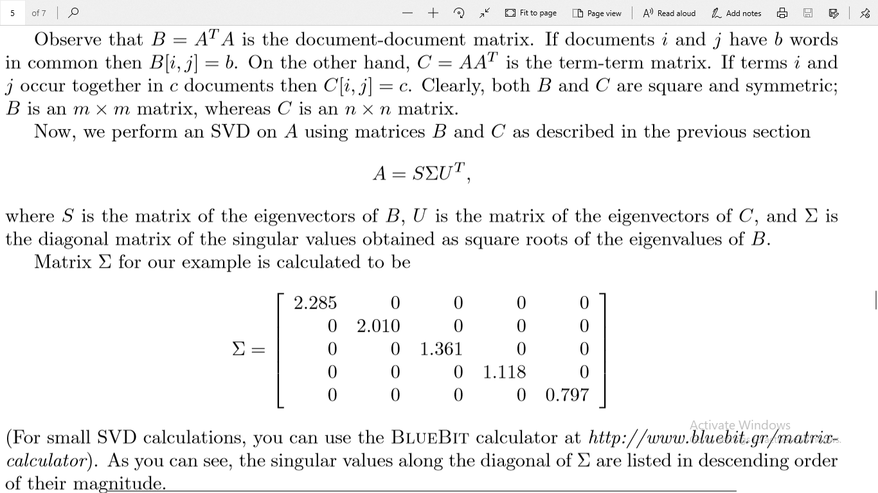

Slide 29
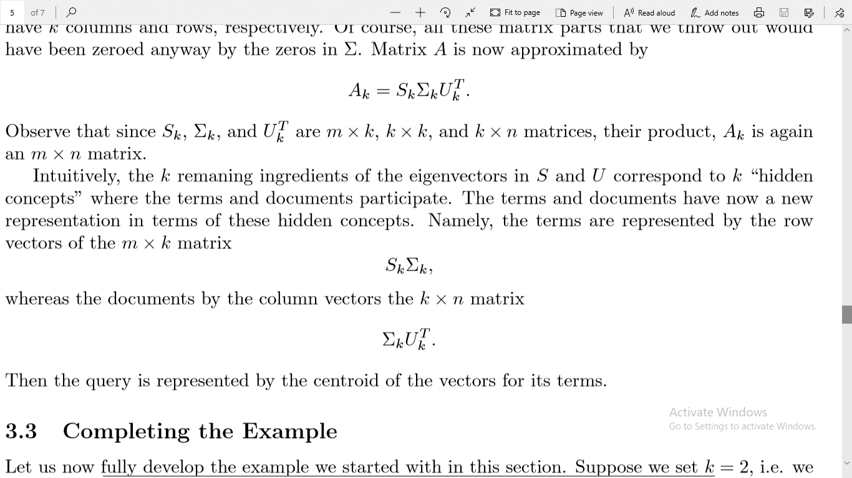

Slide 30
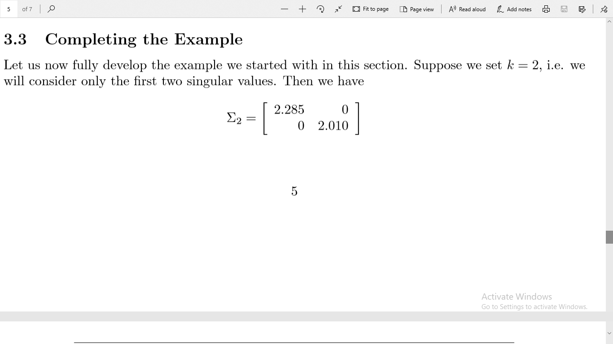

Slide 31
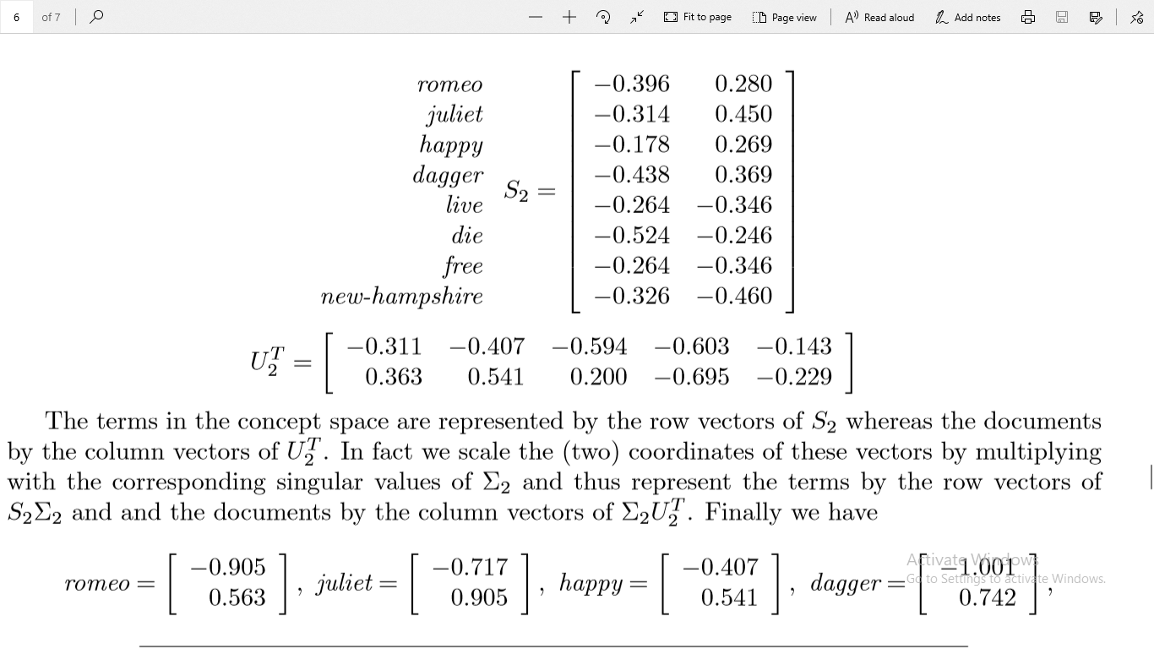

Slide 32
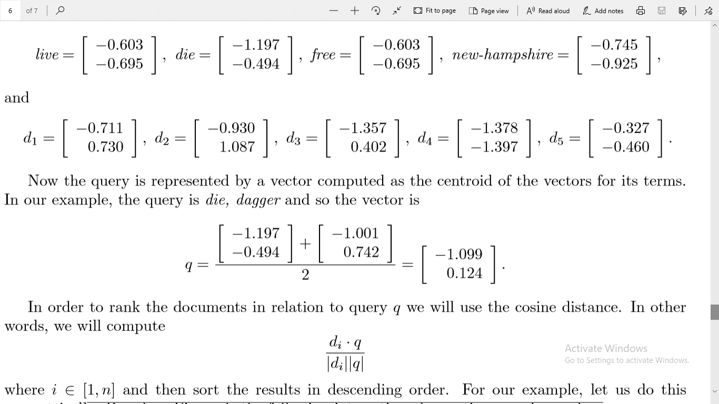

Slide 33
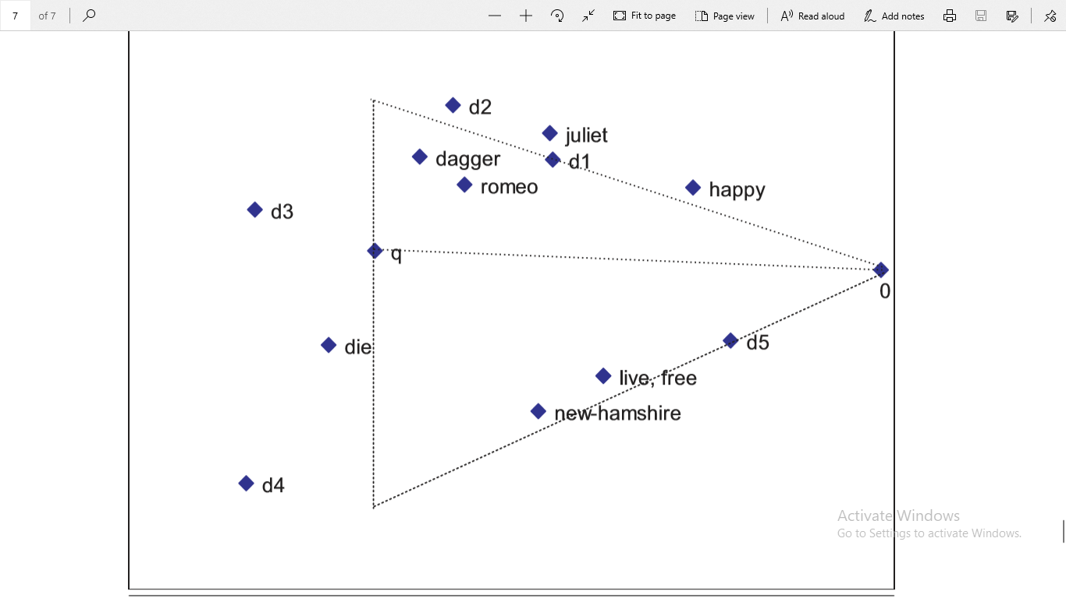

Slide 34


Slide 35
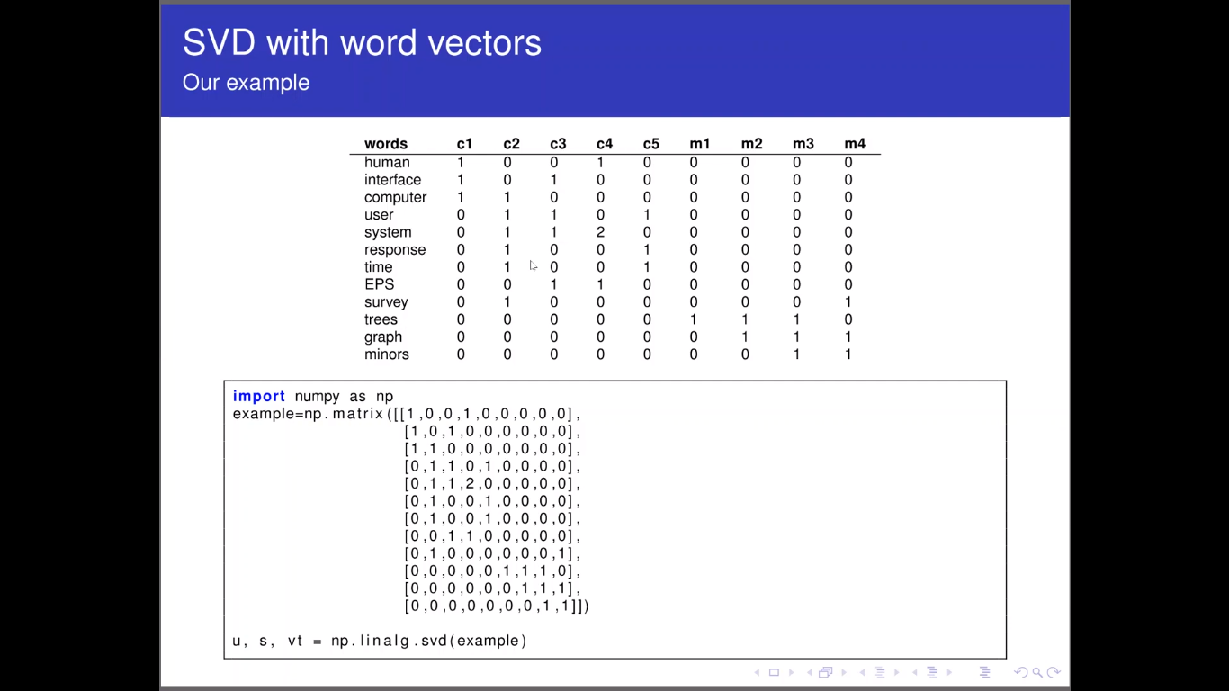

Slide 36
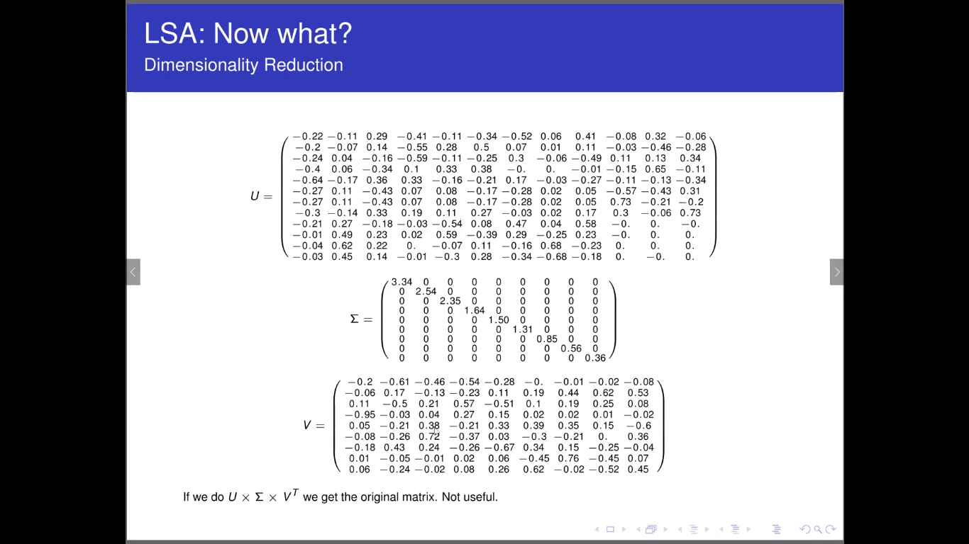

Slide 37
Recommender Systems

Slide 38
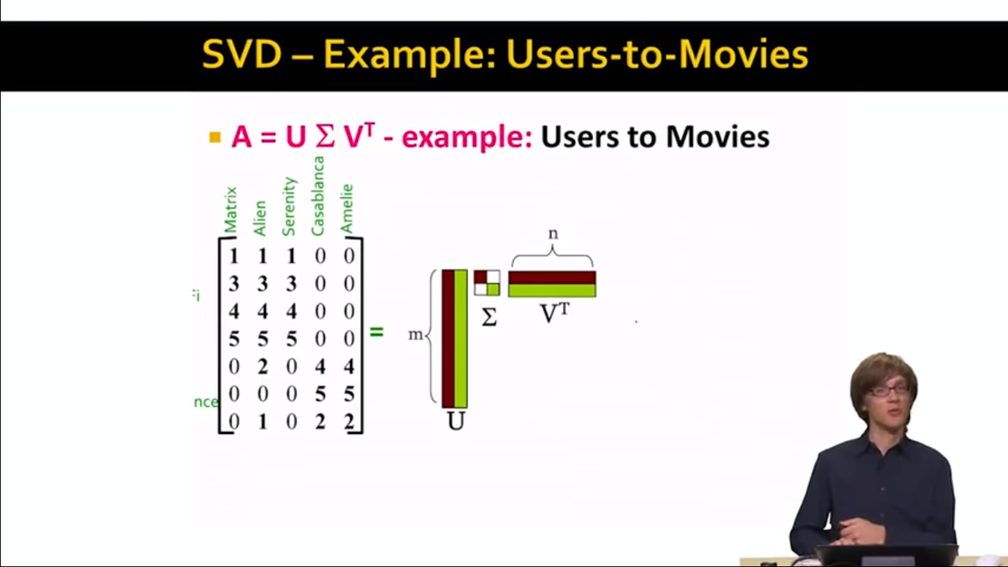

Slide 39
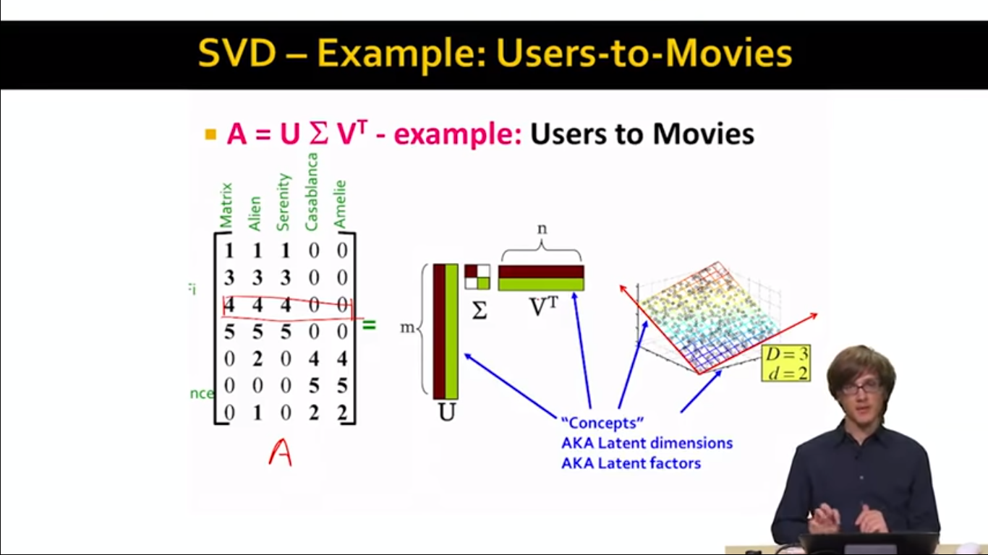

Slide 40
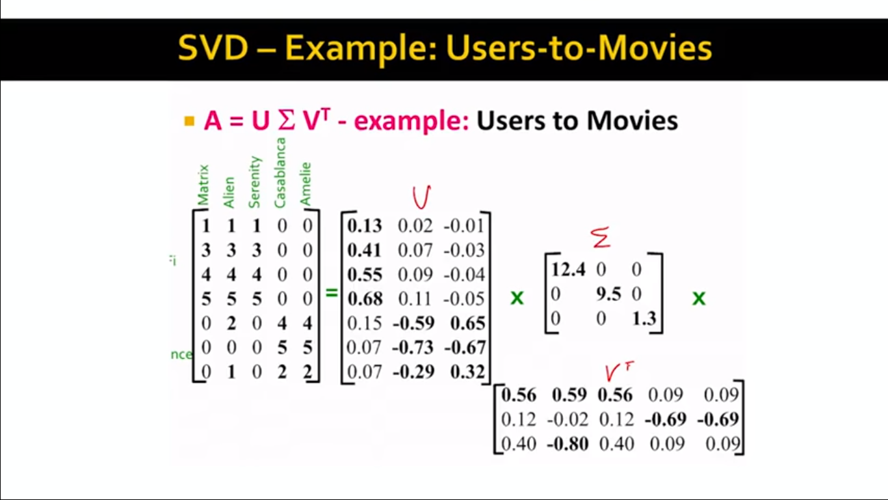

Slide 41
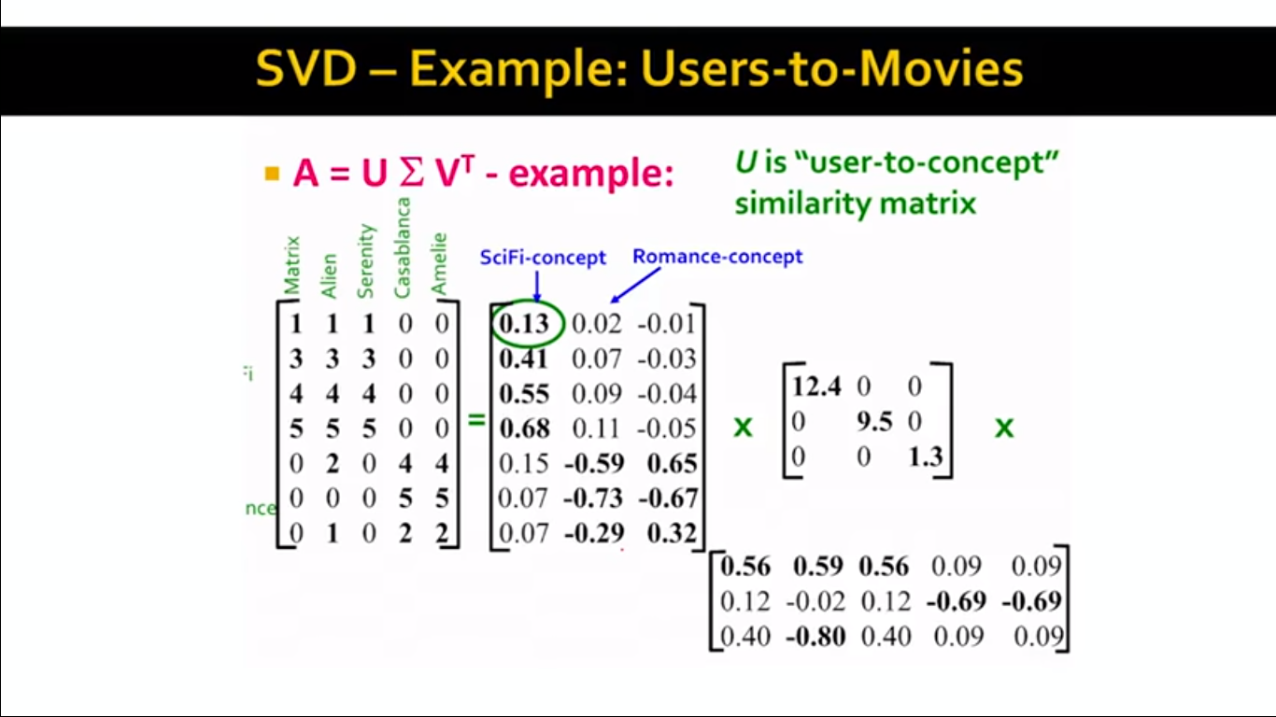

Slide 42
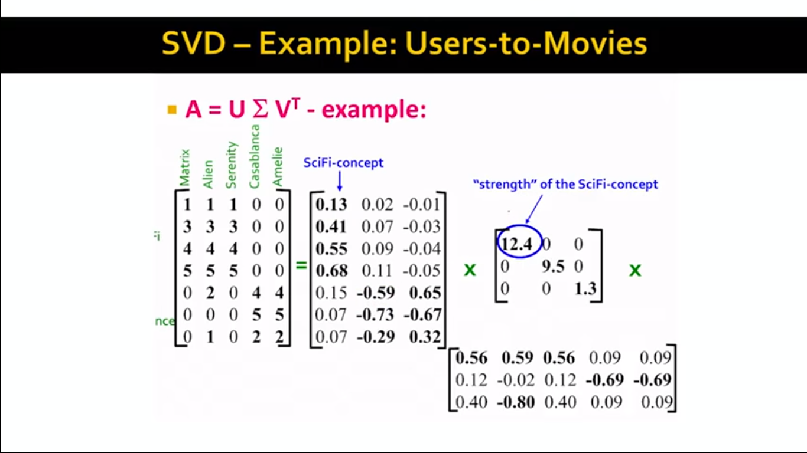

Slide 43
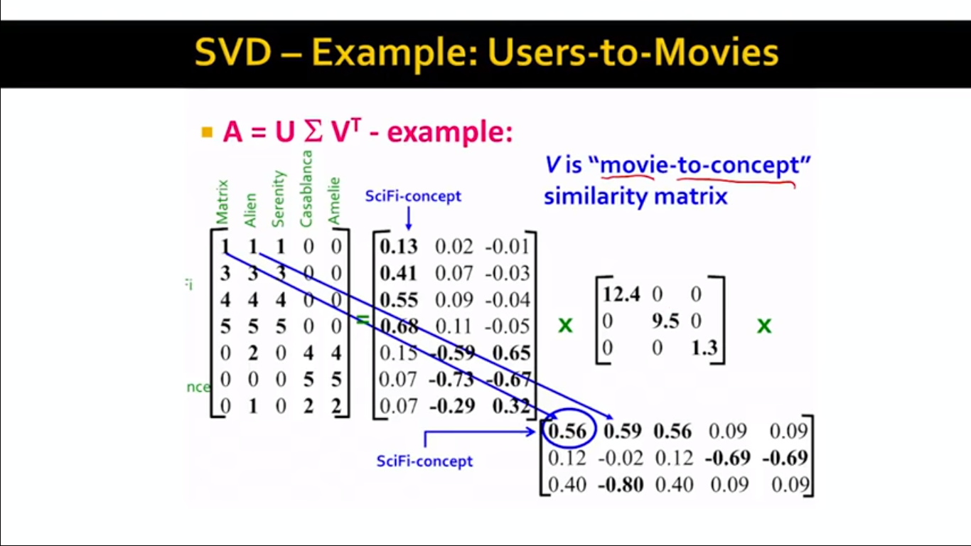

Slide 44
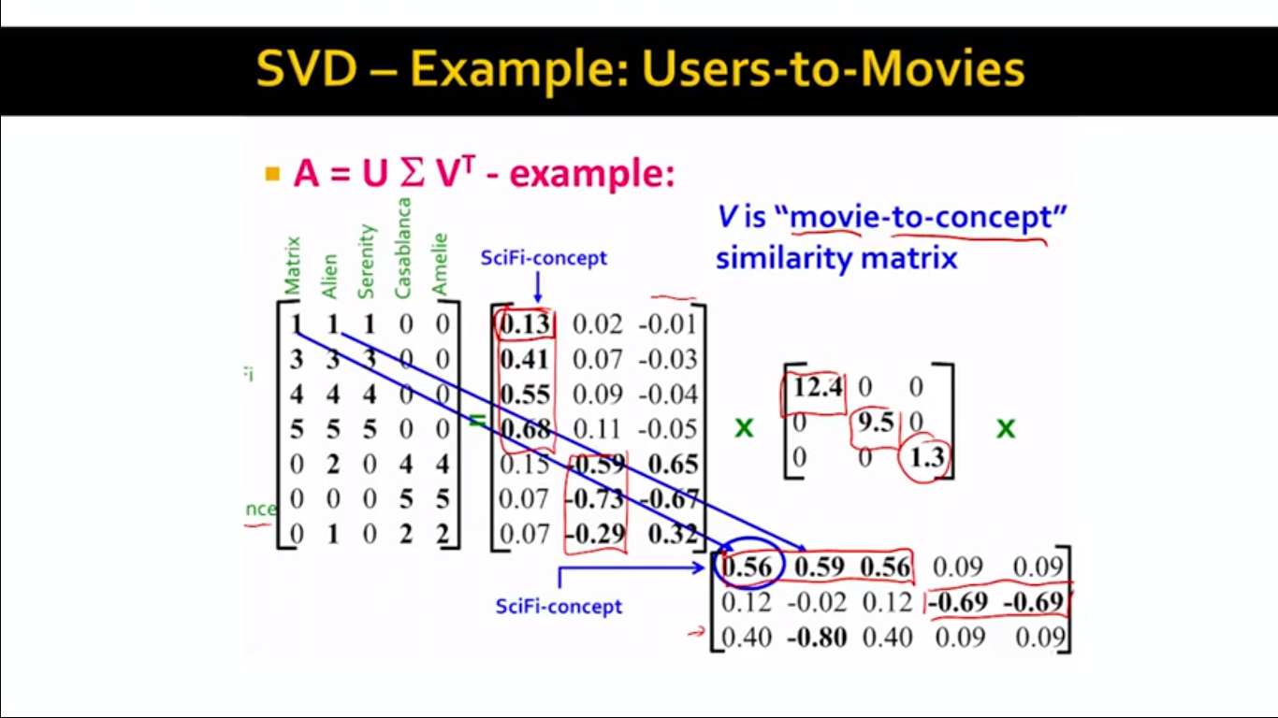

Slide 45


Slide 46
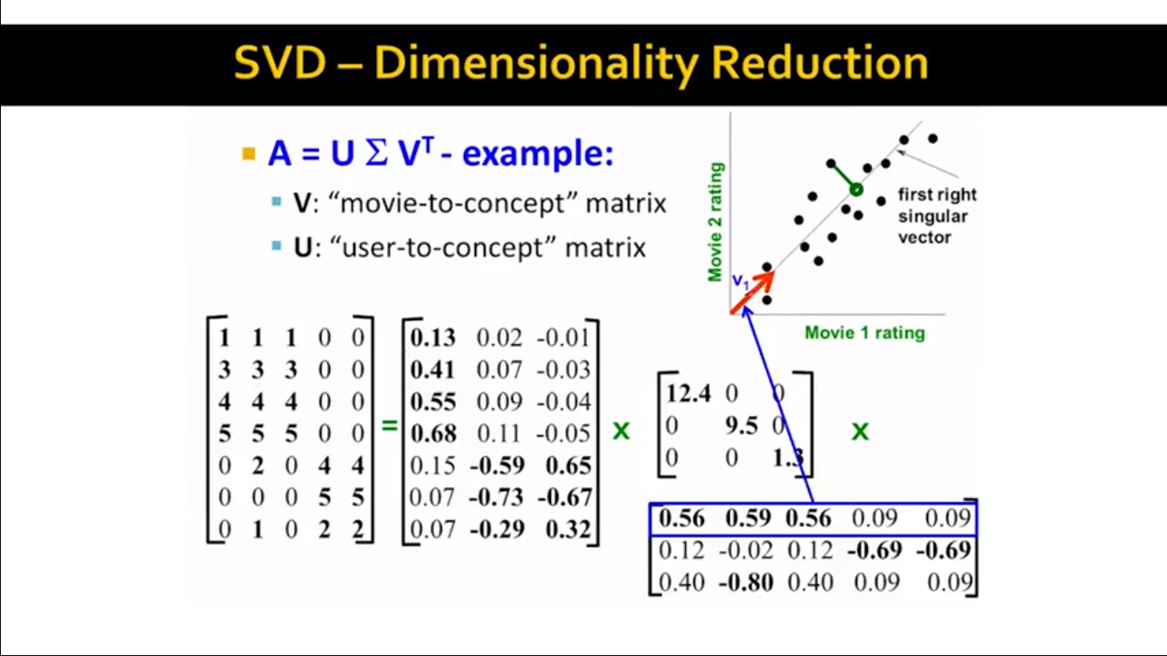

Slide 47
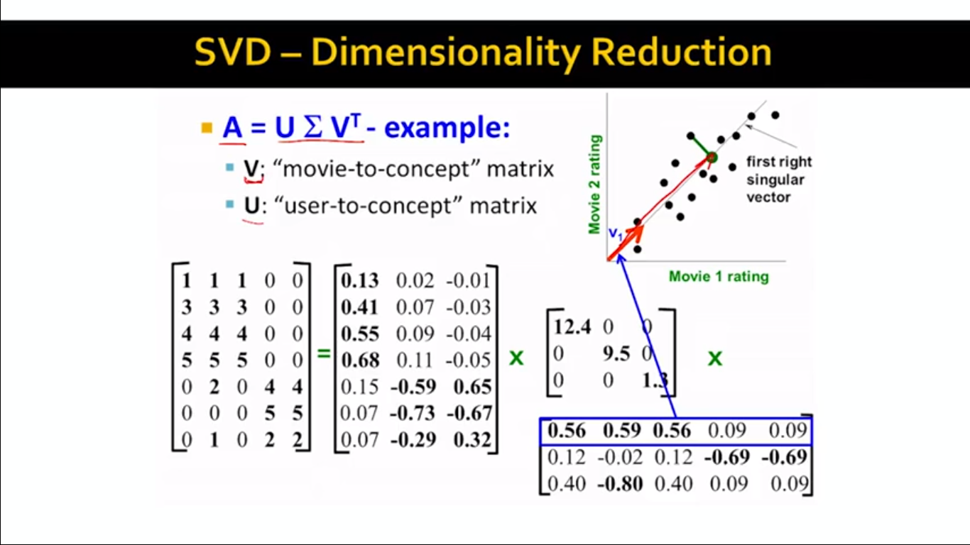

Slide 48
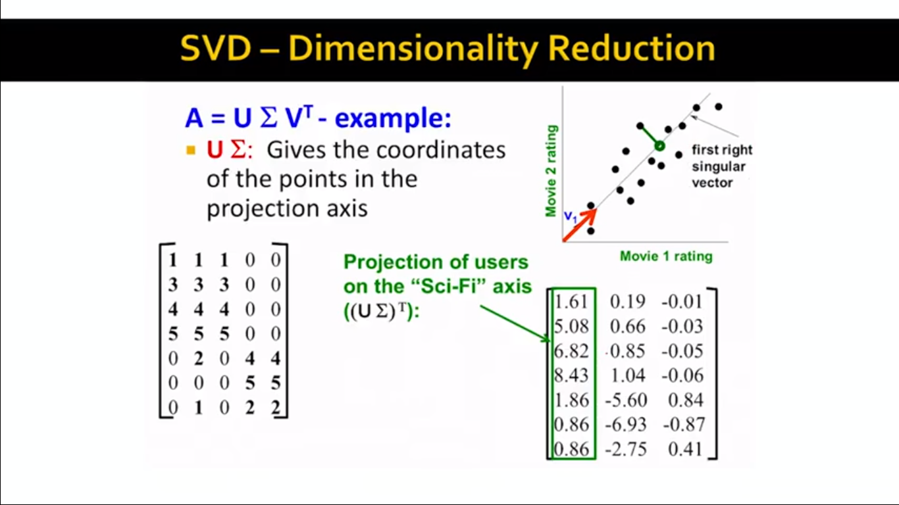

Slide 49
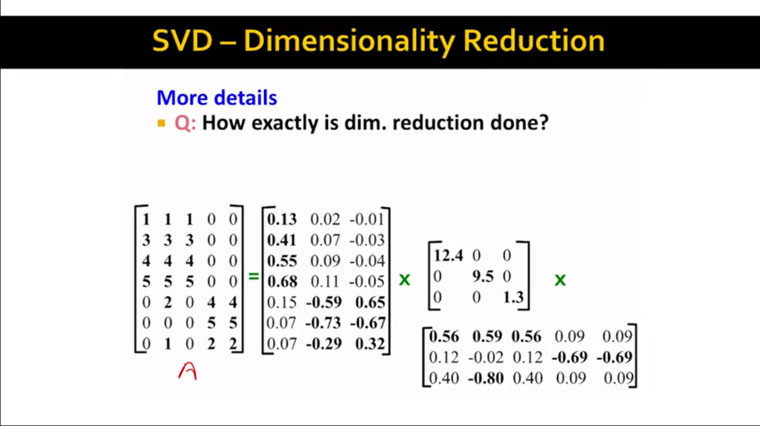

Slide 50
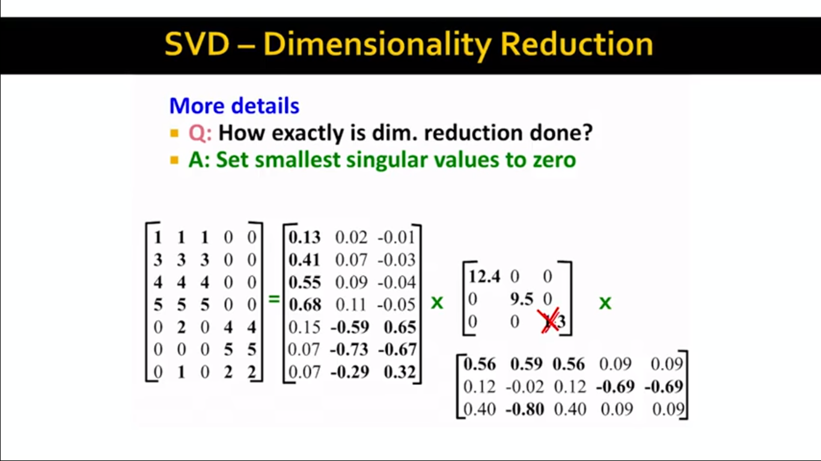

Slide 51
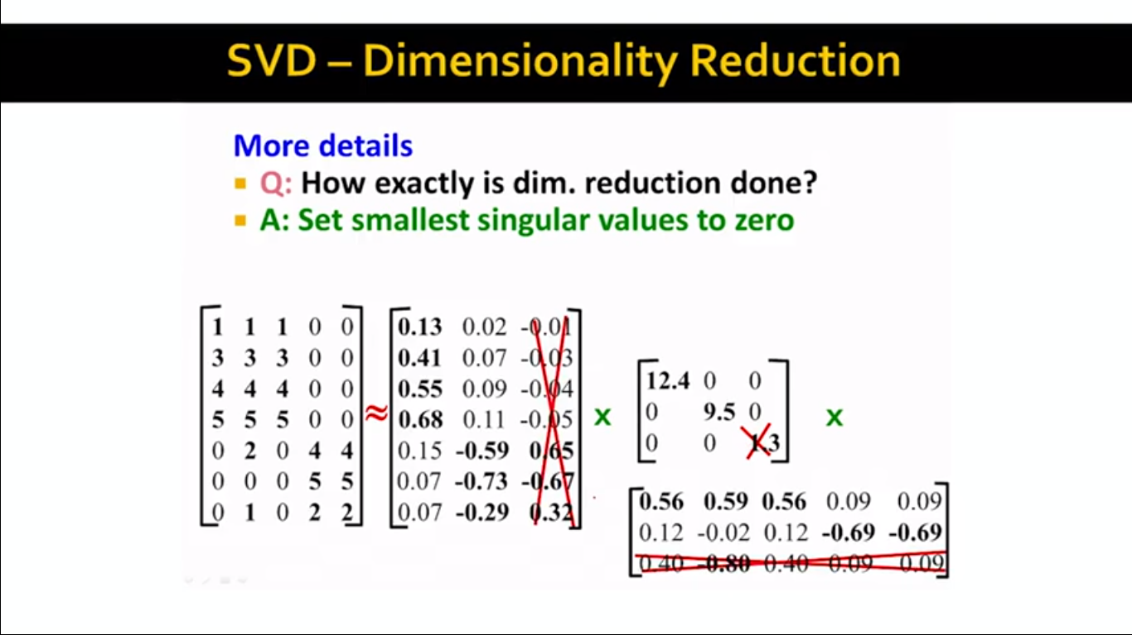

Slide 52
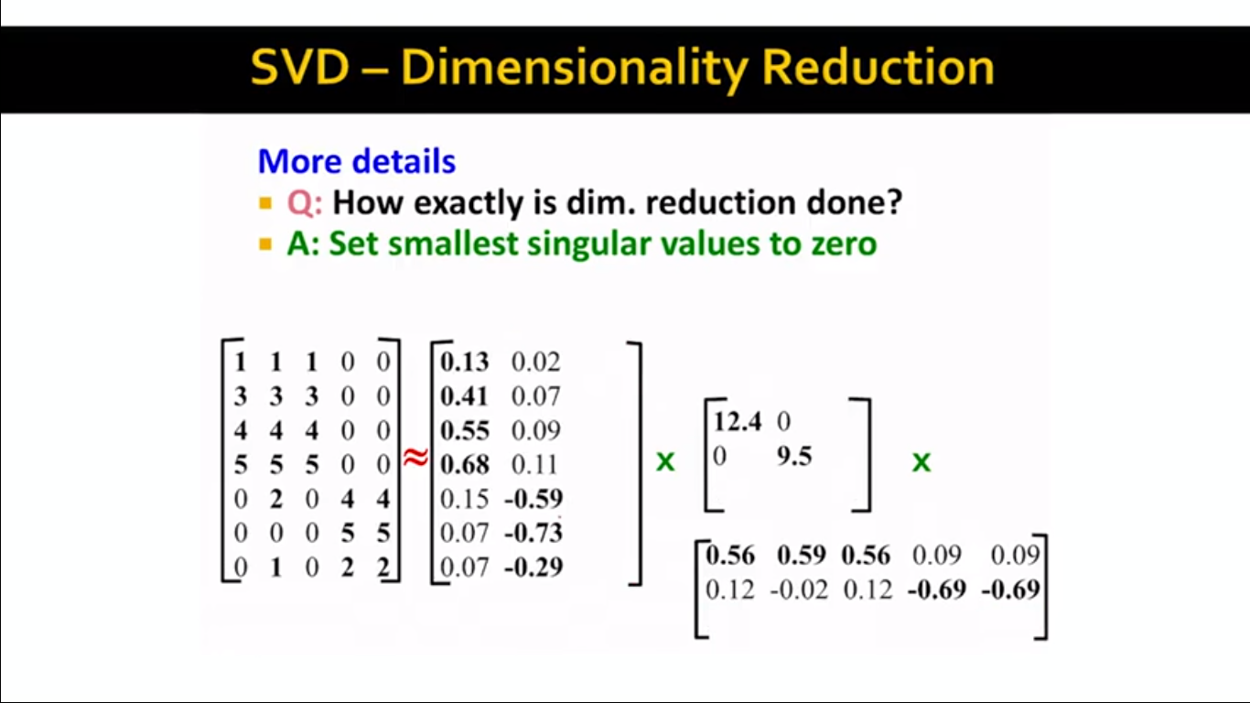

Slide 53
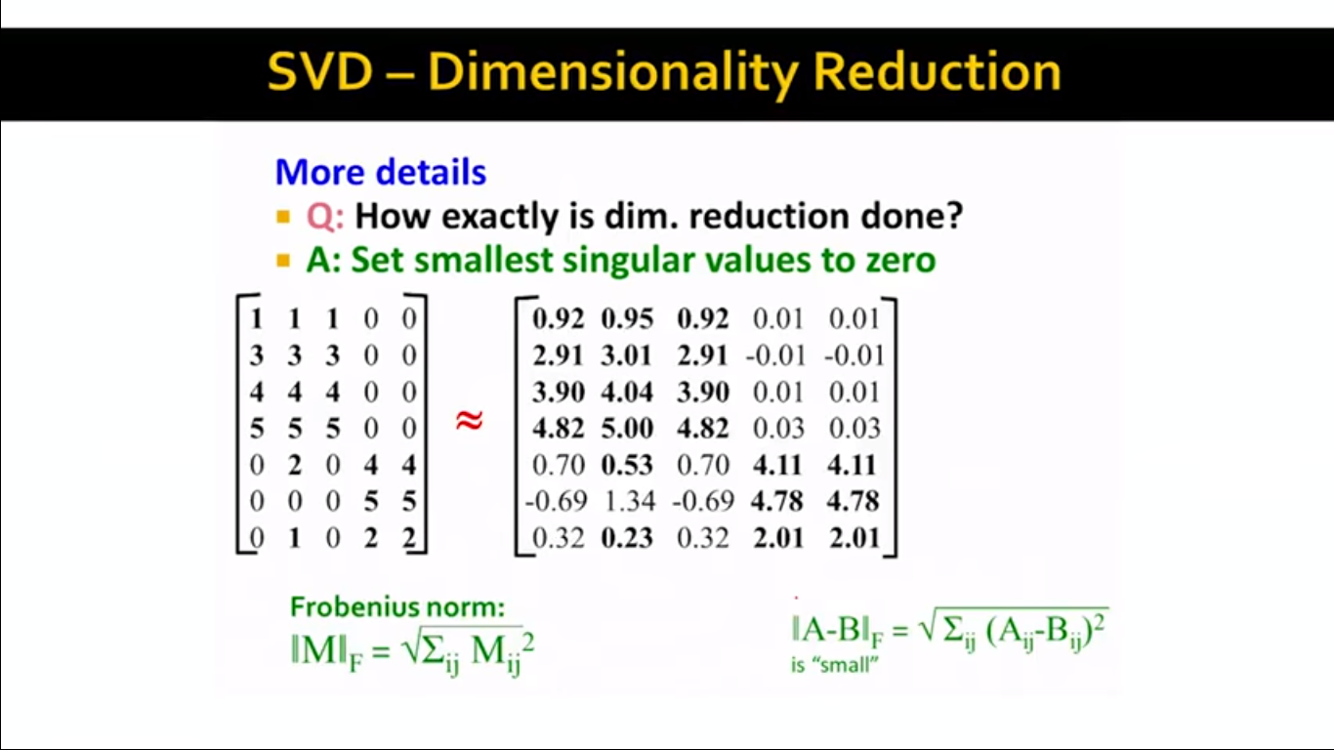

Slide 54
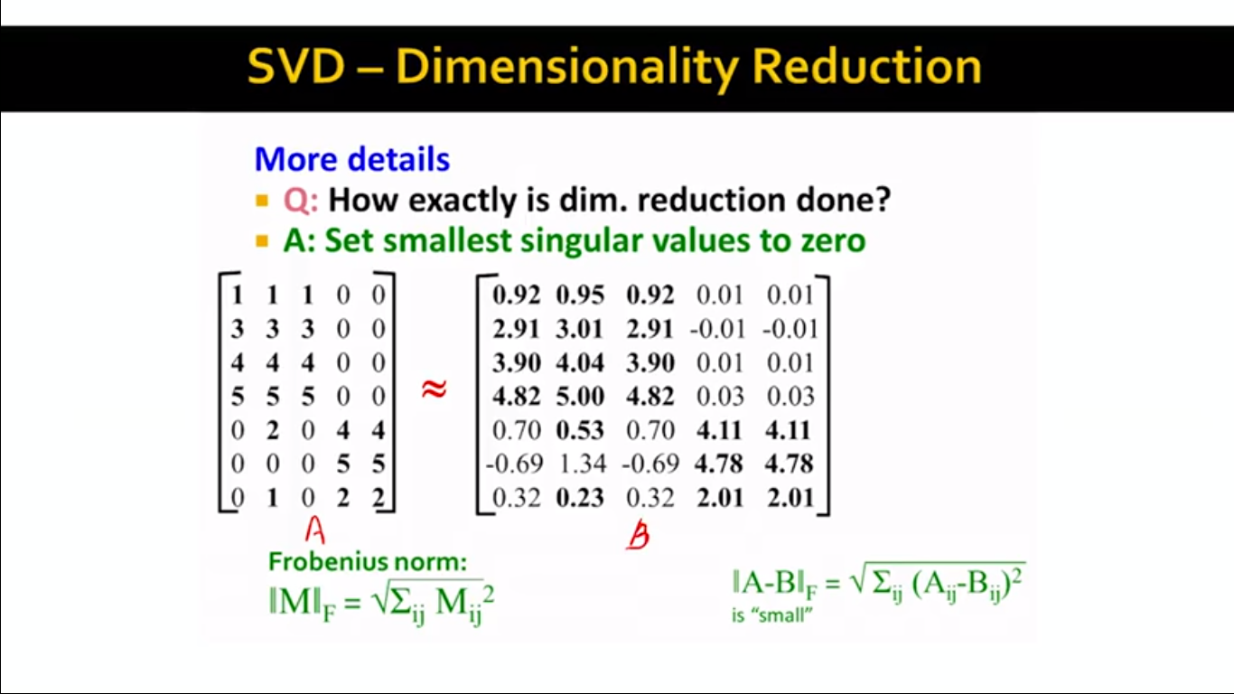

Slide 55
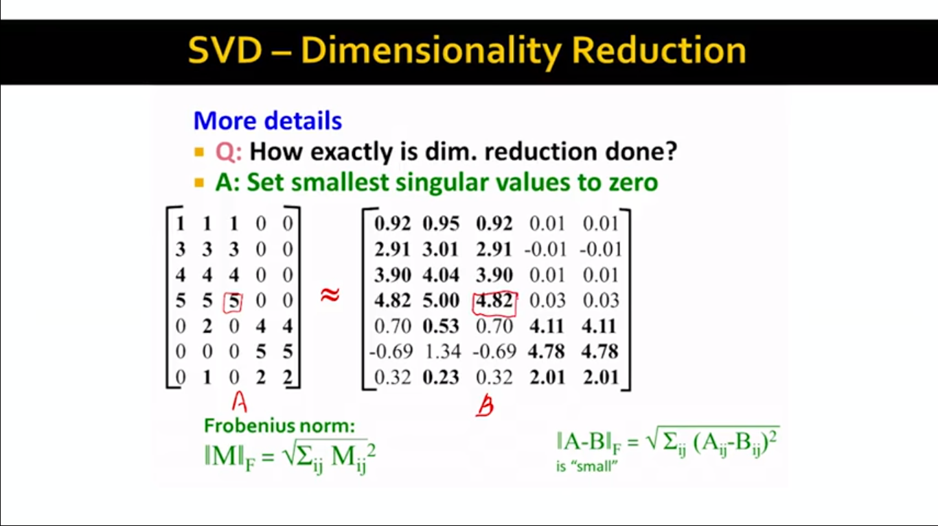

Slide 56
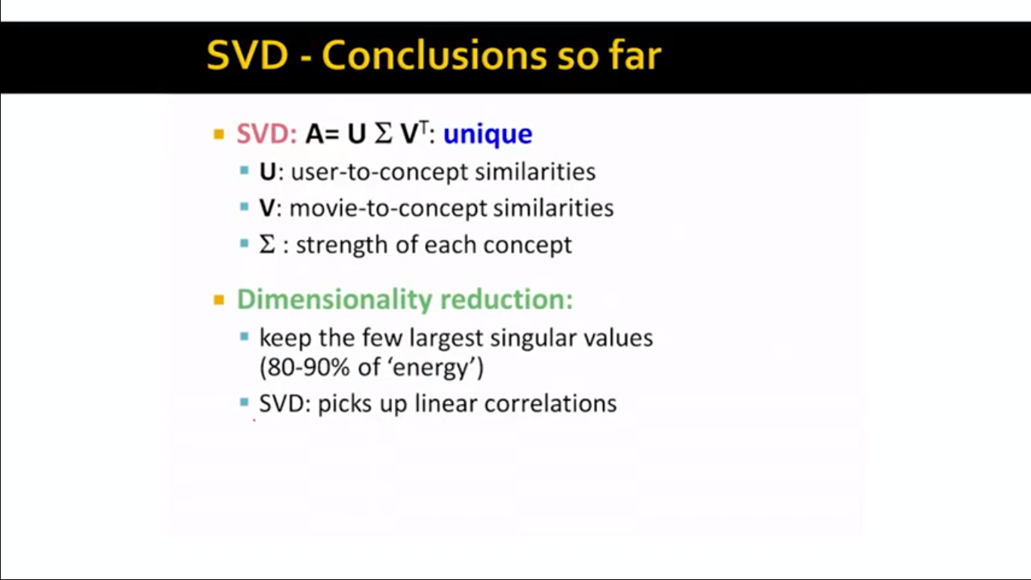

Slide 57
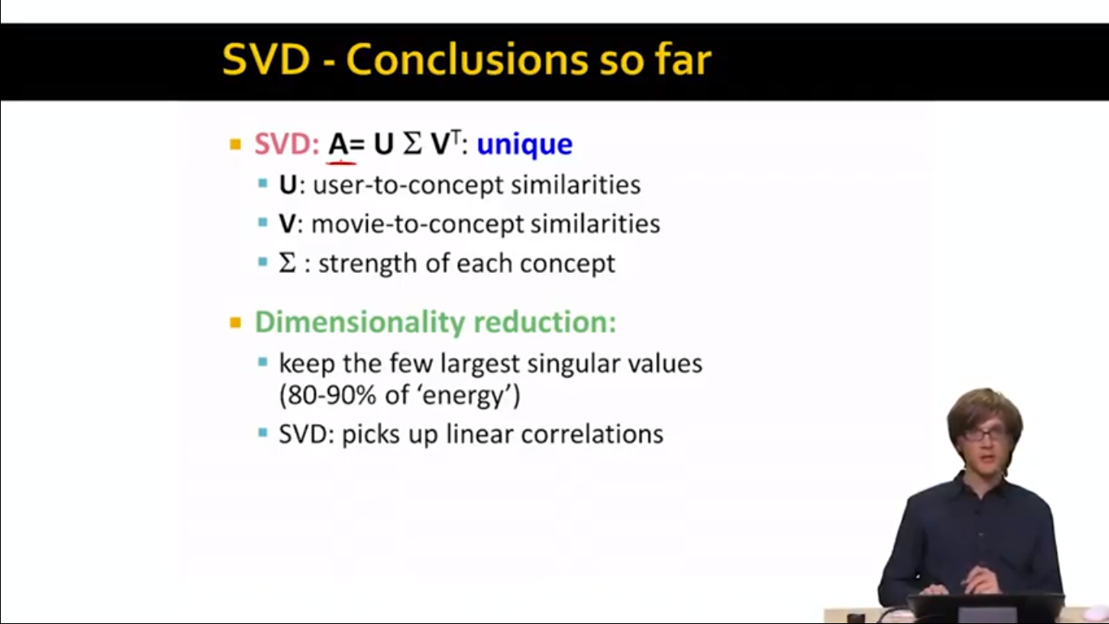

Slide 58


Slide 59


Slide 60


Slide 61


Slide 62


Slide 63
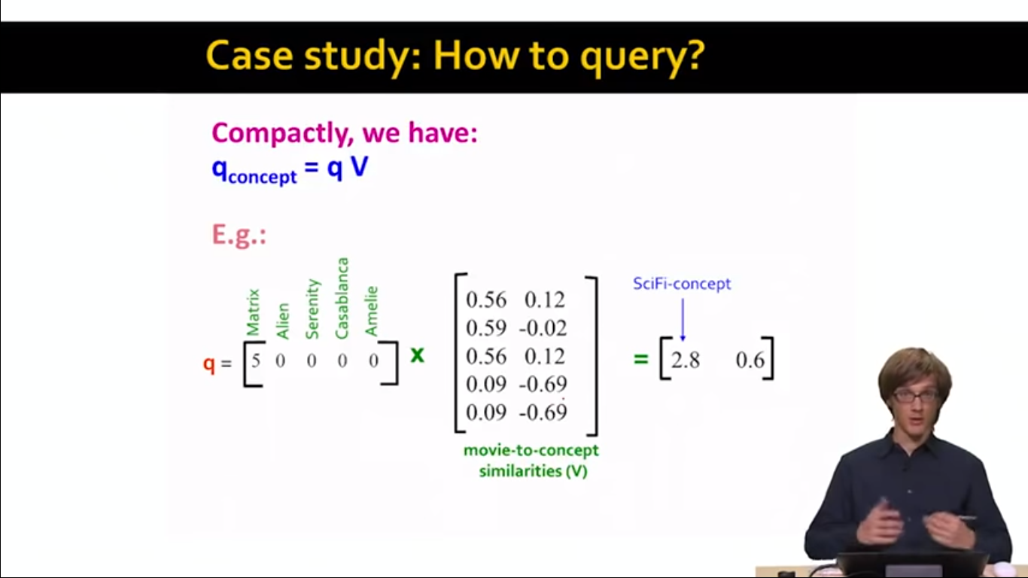

Slide 64
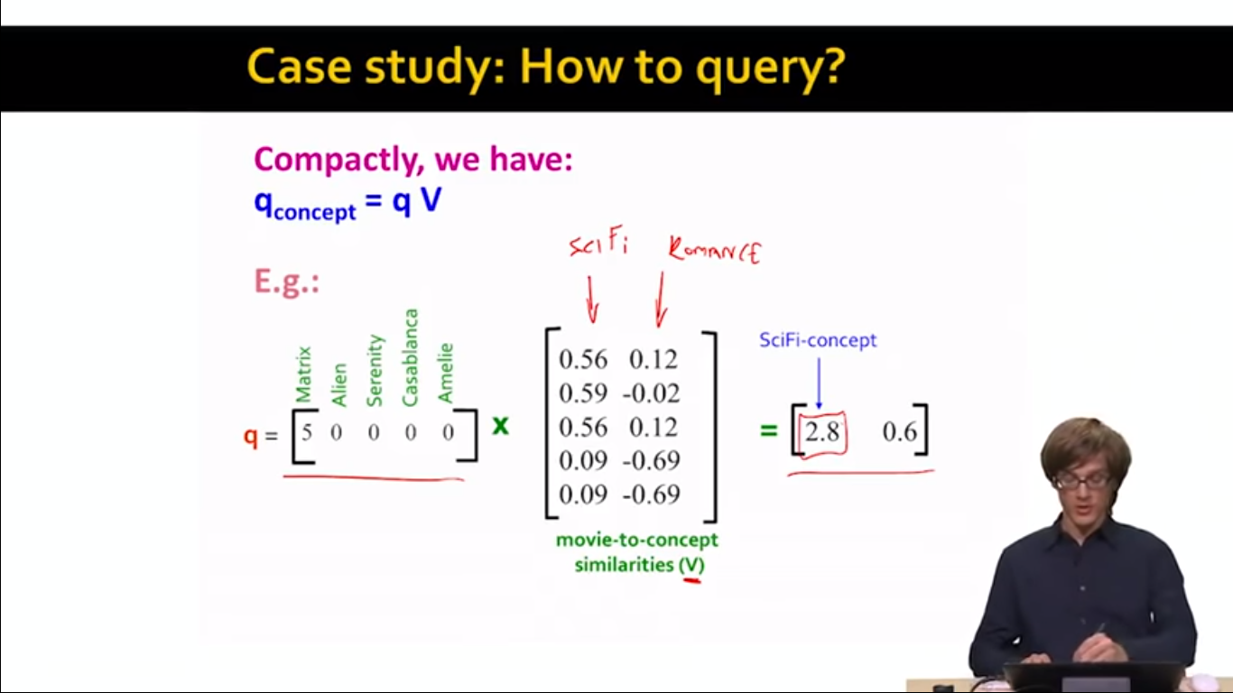

Slide 65
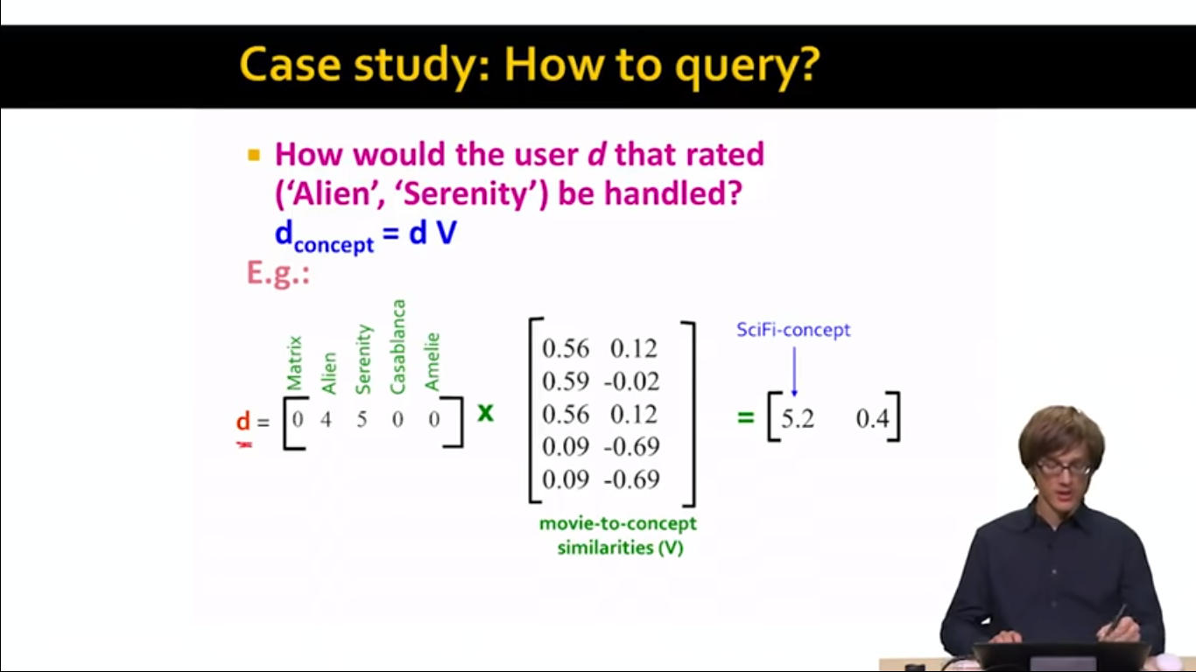

Slide 66
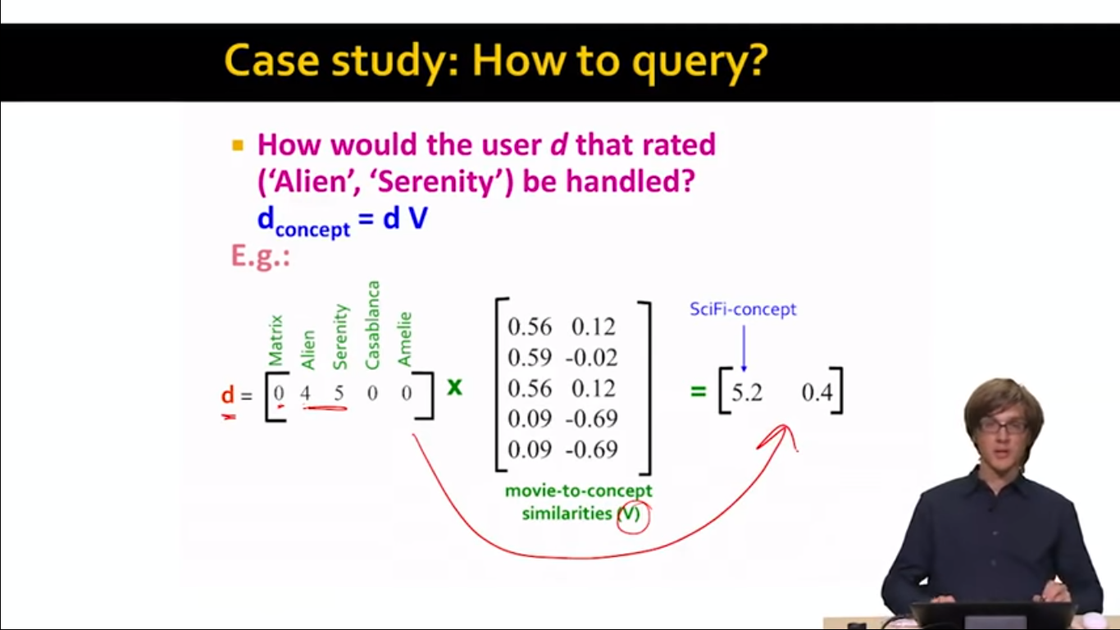

Slide 67


Slide 68
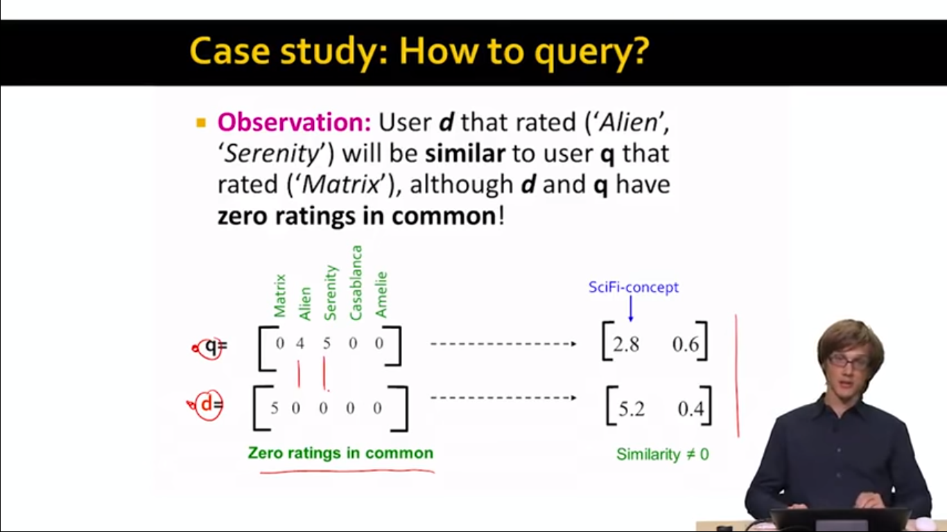

Slide 69


Slide 70
Document Classification and Retrieval

Slide 71
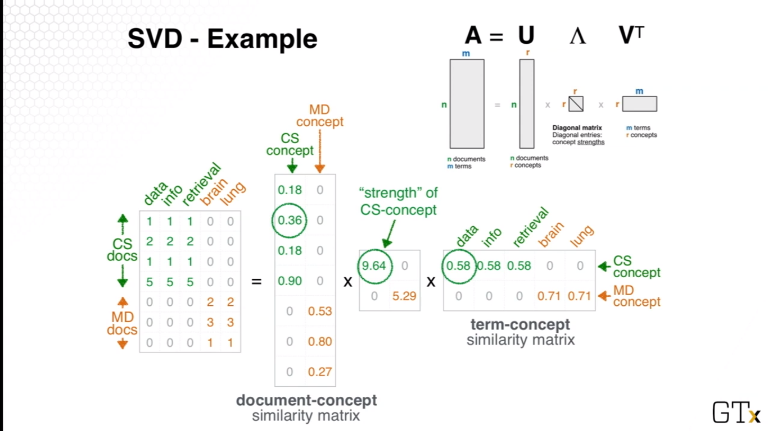

Slide 72
Example procedure to find SVD
Step 1:Calculate AA^{T} and A^{T}A.
Step 2: Eigenvalues and S.
Step 3: Finding U.
Step 4: Finding V.
Step 5: The complete SVD.

Slide 73
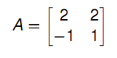
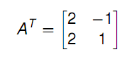

Step 1:Calculate AA^{T} and A^{T}A.
Let then

Slide 74


Step 2: Eigenvalues and S.

Slide 75


Singular Values are
Therefore

Slide 76


Step 3: Finding U.

Slide 77




Slide 78



Step 4: Finding V.
Similarly

Slide 79

Step 5:Complete SVD

